Slide 2
PlayFab + Azure Functions + Visual Studio Code => Crazy Awesome Games!
Martin Gudgin

Slide 3
Agenda
PlayFab
CloudScript
Azure Functions
Demo

Slide 4
What is PlayFab?
Back-end services for games
Platform and language agnostic
Customers range from single developers to AAA studios
“You make it fun, we’ll make it run”

Slide 5
What is CloudScript?
Serverless compute
Trusted data access
Initiated from game client, server or PlayFab
Any game logic

Slide 6
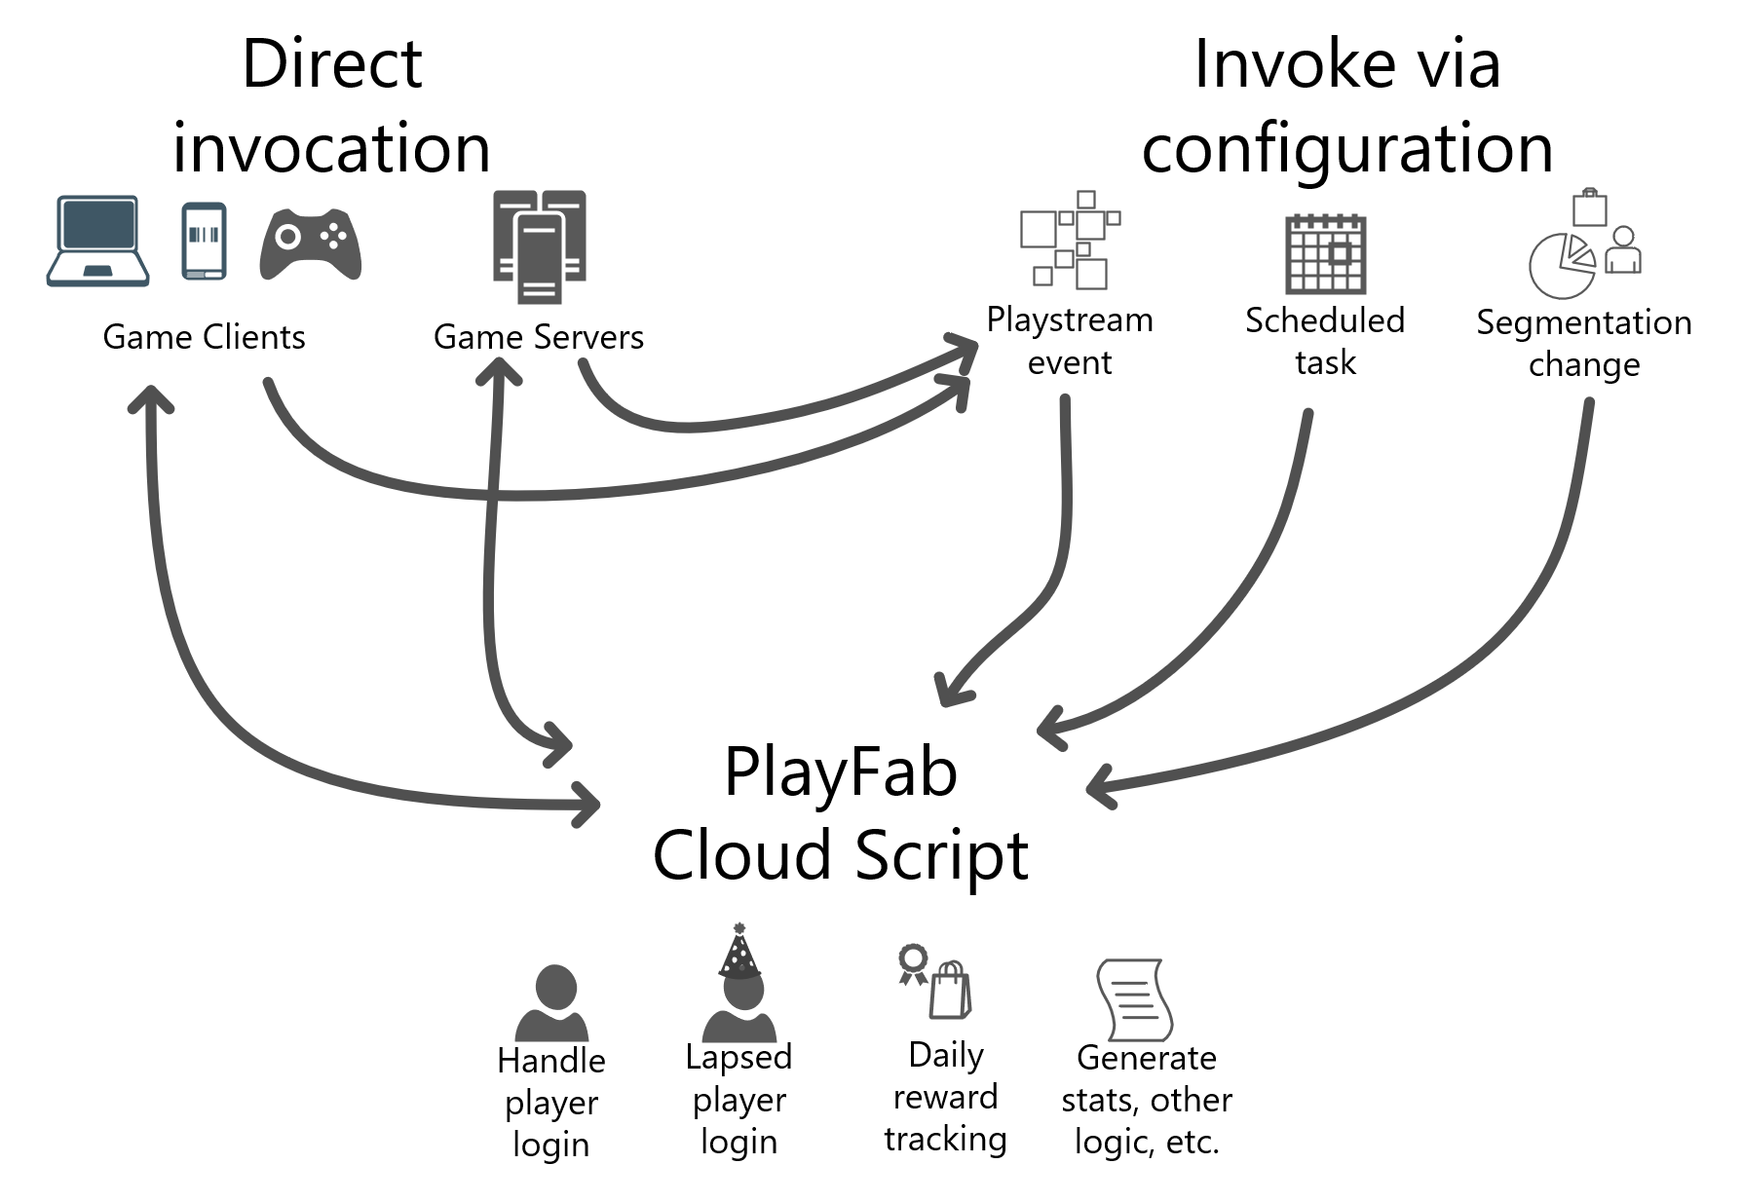

Slide 7
What are Azure Functions?
Serverless compute
Write only the code you need, no additional infrastructure required
Choice of language
Flexible deployment – via dev tools, GitHub, Azure DevOps et.al.
Free Tools – Integrated Extension for VS Code and Visual Studio

Slide 8
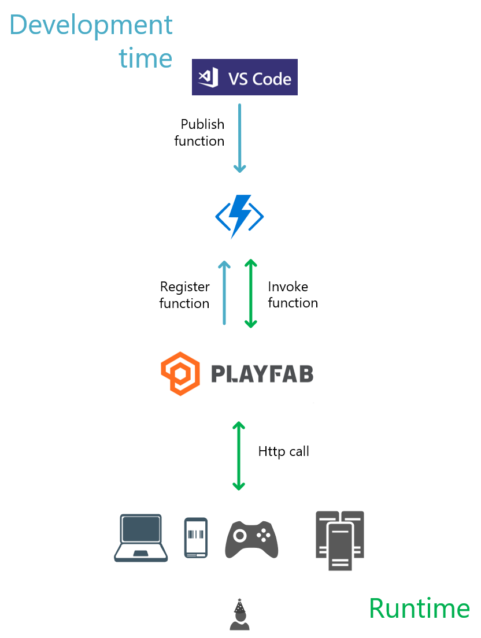
Using the new Cloud Script
Publish your functions to Azure
Register those functions with PlayFab
Add calls from your game client or server or call via config
Notes:
Serverless compute – you write the logic and we’ll handle the infrastructure.
Your clients can call Cloud Script directly or server side events and triggers can call Cloud Script.
Even if you don’t trust data from your clients (replay attacks, clients saying they purchased something, etc.), you can trust the data

Slide 9
Demo
Notes:
Main points;
Have minimal AF app deployed.
Show Game in Game Manager
Show PlayStream (Login a player)
Show title id in Unity game and AF app

Slide 10
Takeaways
Sign up to use PlayFab at playfab.com
Azure Functions CloudScript is in Private Preview
PlayFab Explorer VS Code Extension (Alpha) at https://aka.ms/PlayFabExplorer
My e-mail: gudge@microsoft.com

Slide 11
Q&A

Slide 12
Code Sample Title

